Slide 1
GREEN BALANCED SCORE CARD
PRESENTED BY:
ATHARVA SHARAD LAWAND
ROLL NO:
265

Slide 2
What is balanced scorecard?
A Balanced scorecard monitors the performance of all or part of an organization, towards strategic goals.
It is used in business , industry, government, and nonprofit organizations worldwide to align business activities.
It gives a framework and help what should be done and measure.

Slide 3
Why Implement a Balanced Scorecard?
Increase focus on strategy and results.
Improve communication of the organization’s Vision and Strategy.
To provide a more reliable basis for awarding incentive based pay.
Employee Satisfaction.
To survive and prosper in today’s world.

Slide 4
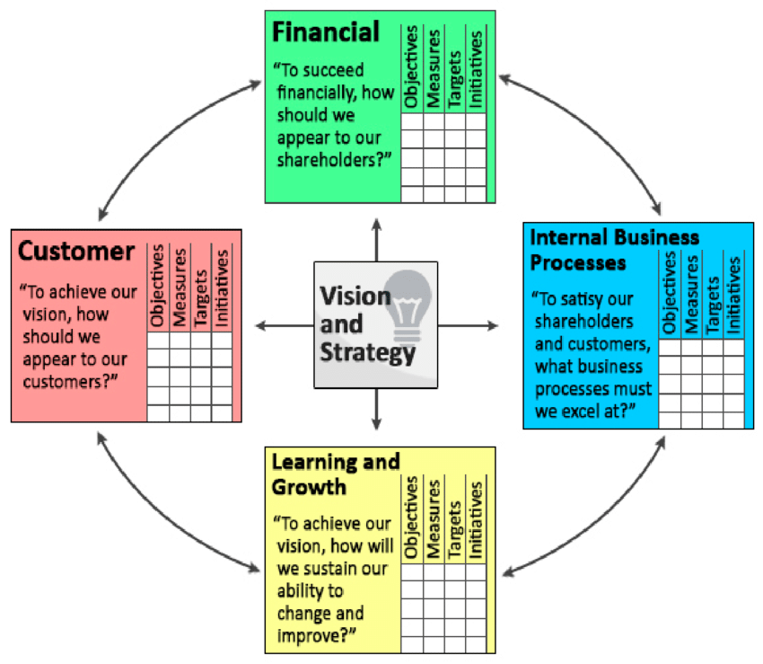
Four Strategic Perspectives

Slide 5
ELEMENTS OF SCORECARD THAT AFFECT THE GREEN IT METRICS MEASUREMENTS.

Slide 6
FINANCIAL MEASURES
Risks associated with environmental fines and penalties:
Investments in equipments and infrastructures that are currently emitting carbon.
This are required to ameliorate the effect/emission of carbon.
Costs associated with reuse and disposal.

Slide 7
CUSTOMER MEASURES
Green product preferences and resultant increase/decrease in sales as a result of green-specific actions by the organization.
Green products is based on demands of customer. Varying the way in which products are promoted.
Pre- and postsales services associated with green products and services.

Slide 8
INTERNAL BUSINESS PROCESSES
Power consumption of internal processes.
Use of technologies in reducing internal power consumption and optimizing processes. E.g., RFID.
Supply chain process that are optimized and that enable conformation to set carbon limits. E.g., procurement of materials.
Recycling, reuse, and disposal of materials and equipments.

Slide 9
LEARNING AND GROWTH
Training and education of employees and other users
(E.g., customers using the internet-based services of a bank).
Ascertaining attitude through survey questionnaires.
Green HR and its support (E.g., for telework, video conferencing).

Slide 10
THANK YOU

